Slide 1
Vegetable Price Prediction Project
Forecasting vegetable market prices using data analysis
Notes:
AI-generated content may be incorrect. ---

Slide 2
Introduction
Notes:
Project Objective and Tools

Slide 3

Project Objective and Tools
Project Objective
The project aimed to predict tomato prices based on prices of other vegetables using historical data from 2023.
Dataset Overview
Dataset contained daily vegetable prices collected throughout 2023 for analytical modeling.
Tools Used
Python libraries like Pandas, Scikit-learn, Matplotlib, and Seaborn were used for data manipulation, modeling, and visualization.
Practical Application
The project was part of an AI Academy Capstone emphasizing real-world predictive modeling in agriculture markets.
Notes:
The primary objective of this project was to predict Tomato prices using the prices of other vegetables as features. The dataset comprised daily vegetable prices collected from January to December 2023. The analysis leveraged a suite of Python-based data science tools, including Pandas for data manipulation, Scikit-learn for machine learning, and Matplotlib and Seaborn for data visualization. The project was conducted as part of the EXPLORE AI Academy Capstone, emphasizing practical application of predictive modeling techniques in the context of agricultural market data.

Slide 4
Data Overview
Notes:
--- This slide references information from the following file: https://pandas.pydata.org/about/citing.html Dataset Structure and Scope

Slide 5
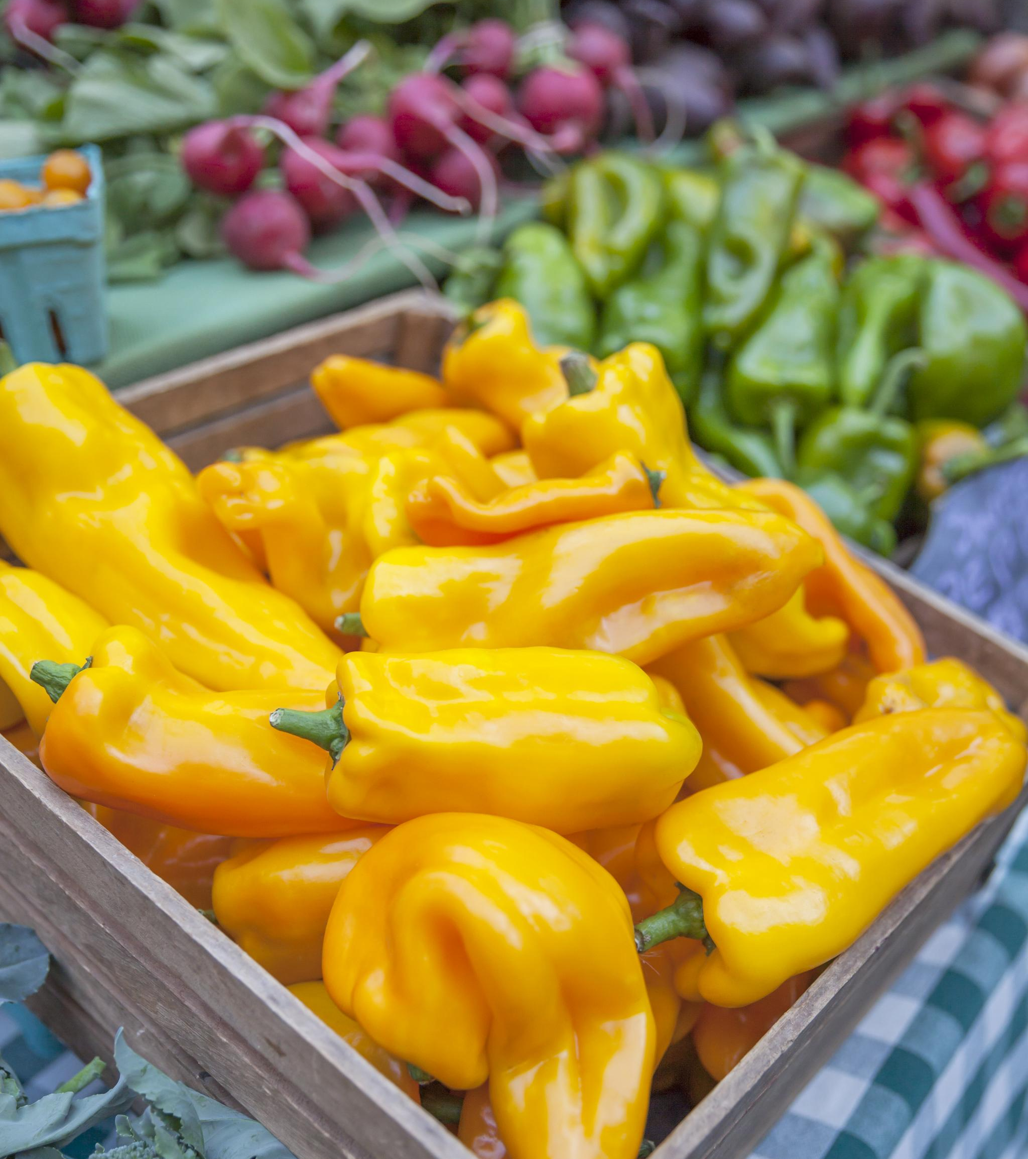
Dataset Structure and Scope
Comprehensive Daily Records
The dataset includes 366 daily entries for vegetable prices throughout the entire year of 2023, ensuring complete time coverage.
Variety of Vegetables
Price data covers a diverse set of vegetables including Bhindi, Tomato, Onion, Potato, Brinjal, and others, offering broad market insights.
Time Series and Predictive Analysis
The dataset supports time series analysis and predictive modeling to analyze seasonal trends and price volatility effectively.
Notes:
--- This slide references information from the following file: https://pandas.pydata.org/about/citing.html The dataset contained a comprehensive record of daily vegetable prices, with a total of 366 entries spanning the full year of 2023. Each record included the date and prices for a variety of vegetables, such as Bhindi (Ladies finger), Tomato, Onion, Potato, Brinjal, Garlic, Peas, Methi, Green Chilli, and Elephant Yam (Suran). The data provided a robust foundation for time series analysis and predictive modeling, capturing both seasonal trends and price volatility across different vegetable types.

Slide 6
Exploratory Data Analysis
Notes:
--- This slide references information from the following file: https://academia.stackexchange.com/questions/5482/how-do-i-reference-the-python-programming-language-in-a-thesis-or-a-paper,https://stackoverflow.com/questions/40897889/cite-various-python-packages-in-paper,https://pandas.pydata.org/docs/,http://citebay.com/how-to-cite/pandas/ Visualizations and Correlations

Slide 7
Visualizations and Correlations
Distribution Visualization
Histograms and box plots were used to visualize the distribution and spread of vegetable prices effectively.
Pairwise Relationships
Scatter plots examined relationships between key vegetable prices like Tomato vs Onion and Potato vs Garlic.
Correlation Insights
Correlation matrix showed low linear correlation between Tomato prices and others, impacting model selection.
Notes:
--- This slide references information from the following file: https://academia.stackexchange.com/questions/5482/how-do-i-reference-the-python-programming-language-in-a-thesis-or-a-paper,https://stackoverflow.com/questions/40897889/cite-various-python-packages-in-paper,https://pandas.pydata.org/docs/,http://citebay.com/how-to-cite/pandas/ Exploratory Data Analysis (EDA) involved generating histograms and box plots to visualize the distribution and spread of vegetable prices. Scatter plots were used to examine pairwise relationships between key vegetables, such as Tomato vs Onion and Potato vs Garlic. The correlation matrix revealed generally low linear correlation between Tomato prices and those of other vegetables, suggesting that simple linear models might not be sufficient for accurate prediction. These insights guided the selection of more sophisticated modeling approaches in subsequent steps.

Slide 8
Modeling
Notes:
Feature Engineering and Model Selection

Slide 9
Feature Engineering and Model Selection
Data Preparation
Dataset was split into 80% training and 20% testing sets and standardized using feature scaling for model stability.
Model Selection
Three regression models were selected: Linear Regression, Random Forest, and Gradient Boosting for price prediction.
Model Evaluation
Models were trained and tested on identical splits using consistent evaluation metrics to ensure fair comparison.
Notes:
The modeling phase focused on predicting Tomato prices using the prices of other vegetables as input features. The dataset was split into training and testing sets (80%/20%), and feature scaling was applied using StandardScaler to ensure model stability. Three regression models were evaluated: Linear Regression, Random Forest Regressor, and Gradient Boosting Regressor. Each model was trained and tested using the same data splits and evaluation metrics to ensure a fair comparison.

Slide 10
Evaluation and Validation
Notes:
Performance Metrics and Cross-Validation

Slide 11

Performance Metrics and Cross-Validation
Model Performance Metrics
Model accuracy was evaluated using RMSE and R-squared to measure prediction quality and variance explained.
Comparison of Models
Random Forest showed perfect predictions, outperforming Linear Regression and Gradient Boosting in test results.
Cross-Validation Technique
Five-fold cross-validation ensured model stability and minimized overfitting during performance assessment.
Notes:
Model performance was assessed using Root Mean Squared Error (RMSE) and R-squared (R²) metrics. Linear Regression achieved an RMSE of 0.17 and R² of 0.0000, indicating poor predictive power. Random Forest Regressor achieved perfect prediction on the test set (RMSE = 0.00, R² = 1.0000), while Gradient Boosting Regressor also achieved RMSE = 0.00 but R² = 0.0000. Five-fold cross-validation was employed to assess model stability and guard against overfitting, with Random Forest consistently outperforming the other models.

Slide 12
Final Model
Notes:
Best Model Selection and Justification

Slide 13

Best Model Selection and Justification
Model Selection
Random Forest Regressor was chosen for its superior predictive performance on the test dataset.
Capturing Non-linear Relationships
The model effectively captured complex, non-linear relationships between tomato and other vegetable prices.
Overfitting Concern
Perfect test results may indicate overfitting; further validation with new data is necessary.
Notes:
The Random Forest Regressor was selected as the final model due to its superior performance, achieving perfect prediction on the test set. This model was able to capture complex, non-linear relationships between Tomato prices and the prices of other vegetables, which linear models failed to do. However, the perfect test performance also raises concerns about potential overfitting, suggesting that further validation with external data or additional features (such as weather or demand) would be beneficial for production deployment.

Slide 14
Conclusion and Future Work
Notes:
Summary, Limitations, and Next Steps

Slide 15

Summary, Limitations, and Next Steps
Model Performance
Ensemble models like Random Forest outperformed linear models in predicting tomato prices using related vegetable prices.
Key Insights
There is no strong linear relationship between tomato and other vegetable prices, highlighting the need for robust preprocessing.
Limitations
Model lacked external factors like weather and demand, and risked overfitting which affected prediction reliability.
Future Directions
Future work will add more data sources, explore time series forecasting, and analyze feature importance for price drivers.
Notes:
The project demonstrated that ensemble models like Random Forest can effectively predict Tomato prices using other vegetable prices, outperforming linear models. Key insights included the lack of strong linear relationships between Tomato and other vegetables, and the importance of robust preprocessing. Limitations included the absence of external factors such as weather or demand, and the risk of overfitting in the final model. Future work should focus on incorporating additional data sources, exploring time series forecasting methods, and leveraging feature importance to better understand price drivers.

Slide 16
References
Notes:
--- This slide references information from the following file: https://www.kaggle.com/datasets/thedevastator/vegetable-and-fruits-prices-in-india-2010-2018,https://nedbank-my.sharepoint.com/personal/nevilleg_nedbank_co_za/_layouts/15/Doc.aspx?sourcedoc=%7BB0D97B9A-FD5B-46F8-922F-9F236F7BA238%7D&file=prices.csv&action=default&mobileredirect=true,https://za-prod.asyncgw.teams.microsoft.com/v1/objects/0-wza-d4-98f3d75bac327d43e5a0e7d04b657681/views/original/generated_image.png,https://za-prod.asyncgw.teams.microsoft.com/v1/objects/0-nza-d4-b448d73337d1af2e8ea178ef4b31c9b7/views/original/generated_image.png,https://za-prod.asyncgw.teams.microsoft.com/v1/objects/0-nza-d4-41b6b91e43e54b8cbe30f48e4a24ac1d/views/original/generated_image.png,https://za-prod.asyncgw.teams.microsoft.com/v1/objects/0-wza-d2-0f499147ff141c6671e089ddce28eb55/views/original/generated_image.png Citations and Data Sources

Slide 17

Citations and Data Sources
Software Libraries
Pandas, Scikit-learn, Matplotlib, and Seaborn were essential software libraries used for data analysis and visualization.
Data Sources
AGMARKNET and Kaggle Vegetable Price Datasets provided crucial data for analysis and modeling in the project.
Research Foundations
The cited academic works established the foundational tools and methodologies for this research project.
Notes:
--- This slide references information from the following file: https://www.kaggle.com/datasets/thedevastator/vegetable-and-fruits-prices-in-india-2010-2018,https://nedbank-my.sharepoint.com/personal/nevilleg_nedbank_co_za/_layouts/15/Doc.aspx?sourcedoc=%7BB0D97B9A-FD5B-46F8-922F-9F236F7BA238%7D&file=prices.csv&action=default&mobileredirect=true,https://za-prod.asyncgw.teams.microsoft.com/v1/objects/0-wza-d4-98f3d75bac327d43e5a0e7d04b657681/views/original/generated_image.png,https://za-prod.asyncgw.teams.microsoft.com/v1/objects/0-nza-d4-b448d73337d1af2e8ea178ef4b31c9b7/views/original/generated_image.png,https://za-prod.asyncgw.teams.microsoft.com/v1/objects/0-nza-d4-41b6b91e43e54b8cbe30f48e4a24ac1d/views/original/generated_image.png,https://za-prod.asyncgw.teams.microsoft.com/v1/objects/0-wza-d2-0f499147ff141c6671e089ddce28eb55/views/original/generated_image.png Key references for this project include: McKinney, W. (2010) for Pandas; Pedregosa et al. (2011) for Scikit-learn; Hunter, J. D. (2007) for Matplotlib; Waskom, M. L. (2021) for Seaborn; and the AGMARKNET and Kaggle Vegetable Price Datasets for data sources. These resources provided the foundational tools and data necessary for the analysis and modeling conducted in this project.

Slide 18
Contributors
Notes:
Project Team and Acknowledgments

Slide 19

Project Team and Acknowledgments
Project Leadership
Neville Gramoney led the project as a BI Data Analyst, driving data analysis and insights.
AI Technical Support
Technical assistance was provided by an AI assistant, enhancing data processing and modeling.
Collaborative Guidance
Instructors, mentors, and peers provided valuable teachings throughout the project.
Outcome and Insights
This resulted in thorough analysis and actionable recommendations for future projects.
Notes:
This project was led by Neville Gramoney, BI Data Analyst, with technical support from Copilot (AI Assistant). The work was completed as part of the EXPLORE AI Academy Capstone, with guidance and feedback from instructors, mentors, and peers. The collaborative effort ensured thorough data preparation, analysis, modeling, and reporting, culminating in actionable insights and recommendations for future work.

Slide 20
Appendix
Notes:
Supplementary Materials

Slide 21
Supplementary Materials
Code Snippets
Supplementary code snippets demonstrate the computational methods used to generate analysis results.
Extended Data Tables
Extended tables provide detailed datasets such as full correlation matrices across all variables.
Additional Visualizations
Visual aids include feature importance plots, price trend graphs, and outlier detection charts for deeper insights.
Notes:
The appendix contains supplementary code snippets, extended tables, and additional visualizations that support the main analysis. Examples include feature importance plots from the Random Forest model, the full correlation matrix of all vegetables, monthly average price trends, and outlier detection visualizations. These materials provide deeper insights and validation for the findings presented in the main report.

